Slide 1
CAPSTONE Title
Career Title A:
Career Title B:
Teacher:_________ Block:___ for: Sodaro

Slide 2
Big Idea #1 My Learning Story
Career life decisions are influenced by your interests,
accomplishments, passions, goals, and challenges.
• Artifacts, Awards, Certificates, Photos/Videos, etc...

Slide 3
Big Idea #2 My Skills Showcase
Demonstrate the skills you have developed that will support your readiness to transition from high school.
Demonstrate your skills in written, audio, visual, or video format.

Slide 4
My Core Competencies
Communication

Slide 5
My Core Competencies
Critical & Creative Thinking

Slide 6
My Core Competencies
Personal & Social Responsibility

Slide 7
Big Idea #3 My Career Exploration & Pathway
Career Pathways include exploration, planning, reflecting, and adapting.

Slide 8
My Plan A
Career Overview

Slide 9
My Plan A
Working Conditions

Slide 10
My Plan A
Salary & Future Outlook

Slide 11
My Plan A
Educational Pathway

Slide 12
My Plan A
Why are you interested in this Career?

Slide 13
My Plan B
Career Overview & Working Conditions

Slide 14
My Plan B
Educational Pathway

Slide 15
My Plan B
Why is this your back up plan?

Slide 16
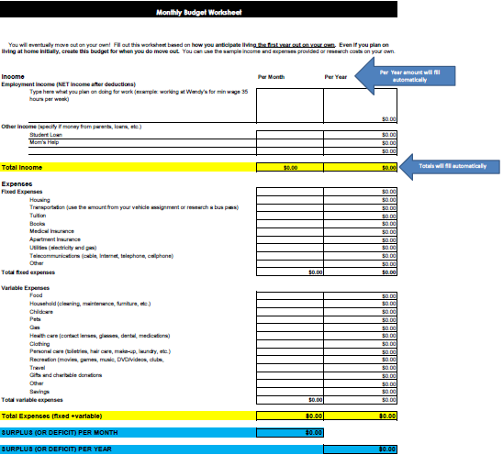
Instructions for: My Plan A Budget
Insert a copy of your Plan A Budget from Planning 11...you must use the Budget from the KSS CAPSTONE Website that looks like this (use next slide & delete this slide when done).

Slide 17
My Plan A Budget

Slide 18
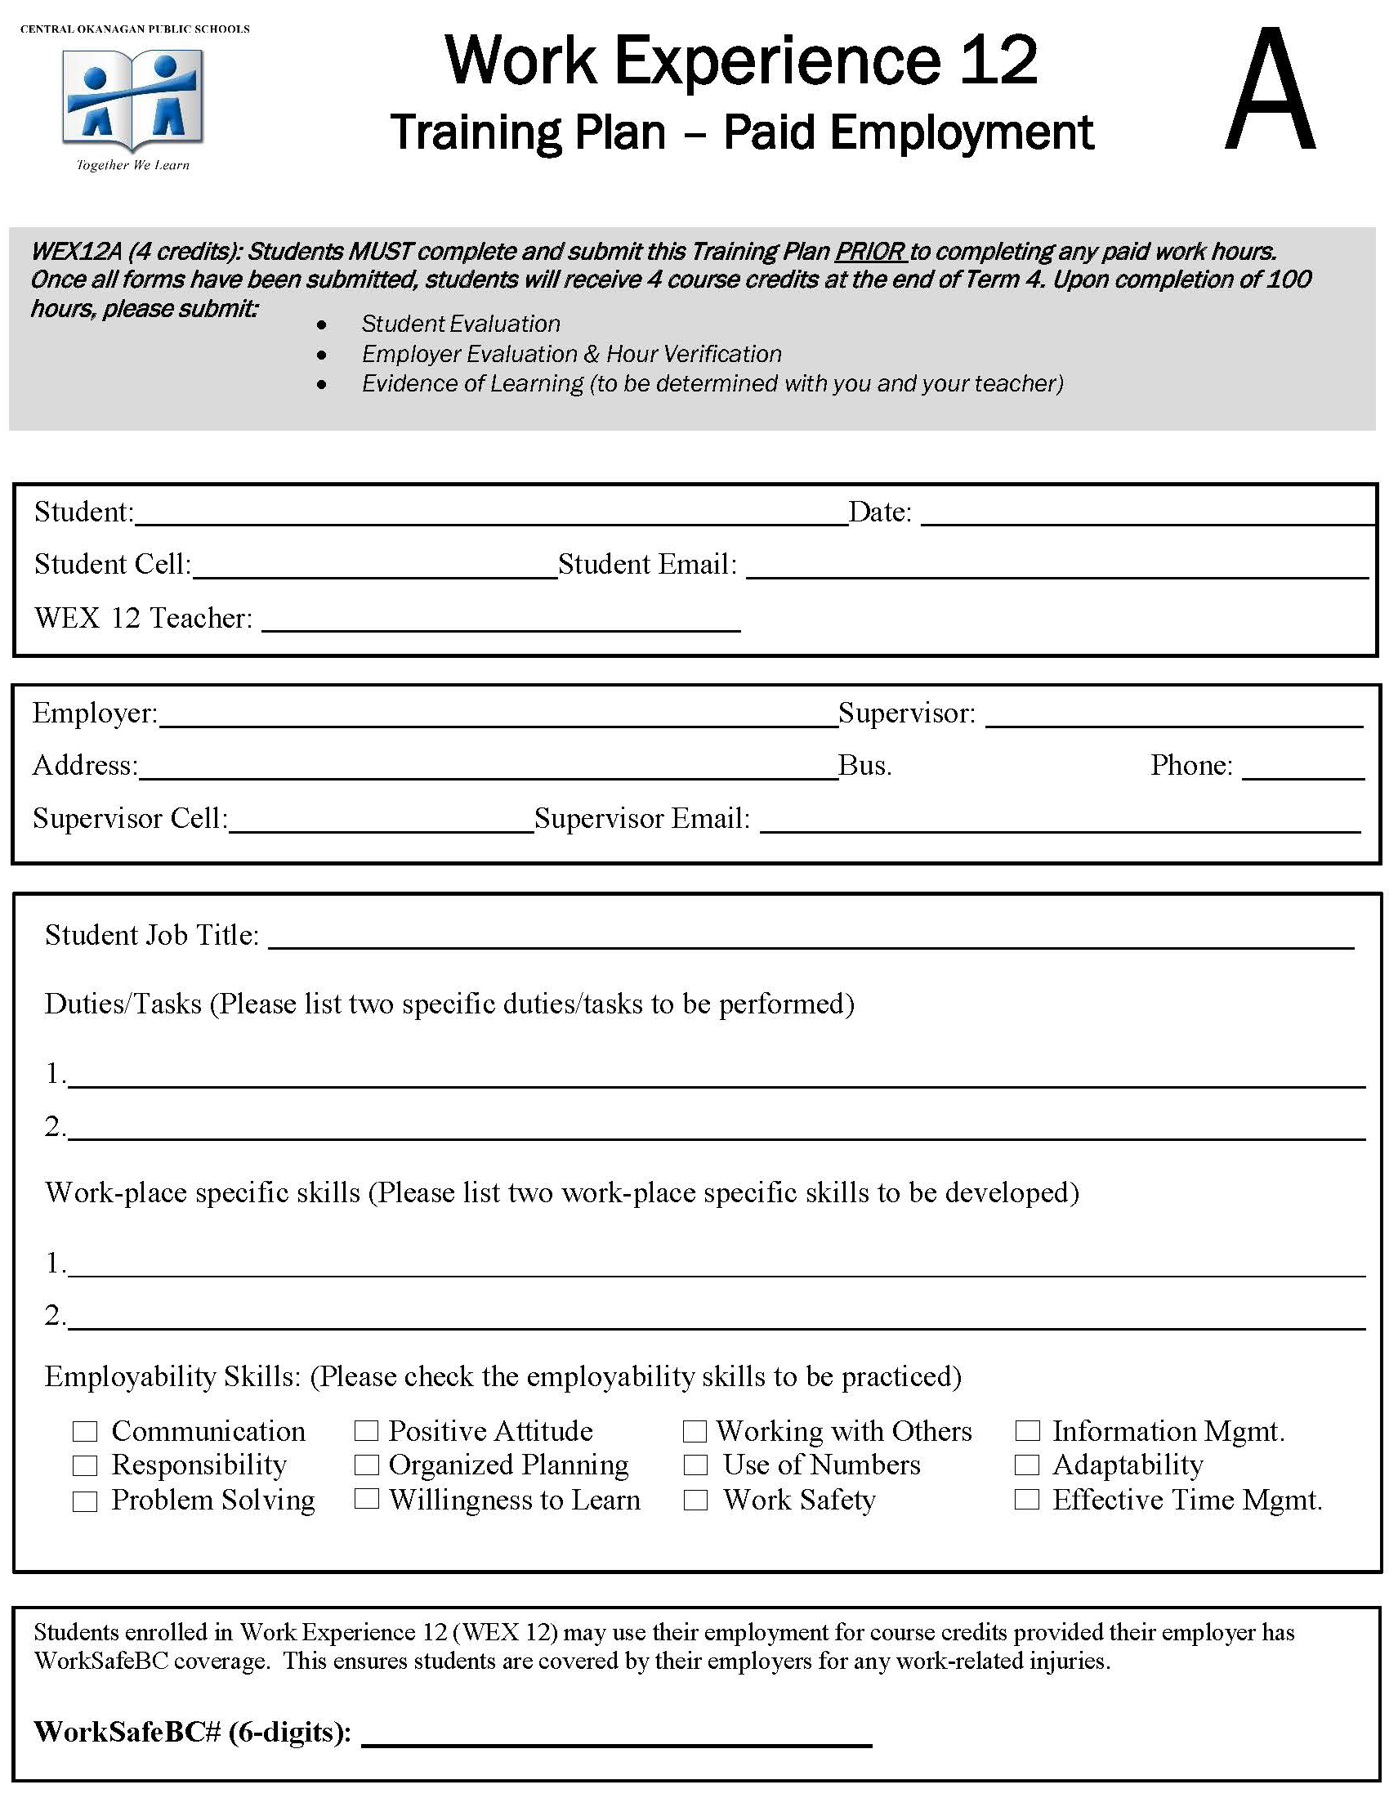
Insructions for: My Work or Volunteer Experience - Part 1
Insert a photo/copy of your Work or Volunteer Experience Orange Form...Please hand in the originals to the Career Center by October 31st (use next slide & delete this slide when done).

Slide 19
My Work or Volunteer Experience - Part 1

Slide 20
Instructions for: My Work or Volunteer Experience - Part 2
Insert a photo/copy of your answers to the 7 questions from the Orange Form...Please hand in the originals to the Career Center by October 31st (use next slide & delete this slide when done).

Slide 21
My Work or Volunteer Experience - Part 2

Slide 22
Big Idea #4 My Mentorship
Collaborate with a mentor to inform career-life development and exploration.
Insert photo/copy of your Job Shadow/Career Interview

